Slide 1
Explorathon 2015
Exploring Computer Science
Through Game Maker

Slide 2



Women in Computer Science

Slide 3
Careers in Computer Science
Software Engineer
Web Application Developer
Mobile Application Developer
Video Game Developer
...and so much more!
Today we will show you what its like to develop a video game and write real code!

Slide 4
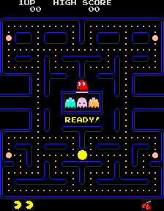
Our Inspiration
The game we will create today is based on the classic arcade game Pacman. We have changed the images and sounds, but the heart of Pacman remains.
We have also supplied a finished version of our game.

Slide 5
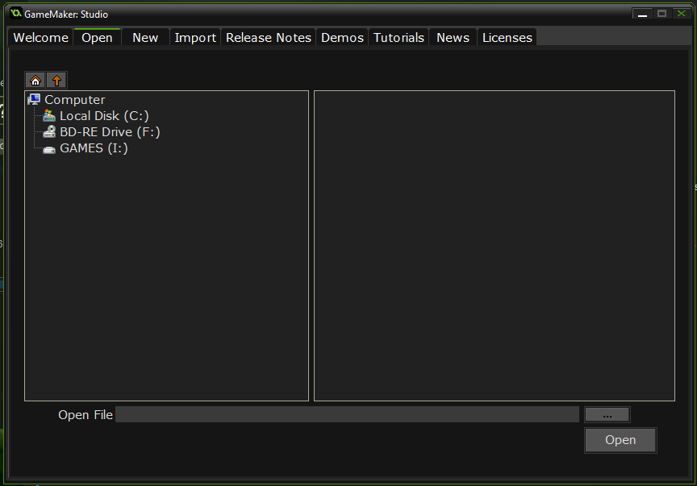
Open the starter project
Open up Game Maker
Click the Open tab
Choose the project (PelletGirl - Start) by navigating to it on your flash drive and opening the .gmx file

Slide 6
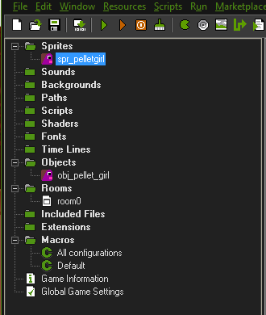
Project Basics
The initial setup of the project comes with:
  The pellet girl sprite
  The pellet girl object
  A room with pellet girl placed in it
  You can view these assets in the resource tree, which can be opened by double clicking them
  Press F5 at any time to run the game

Slide 7
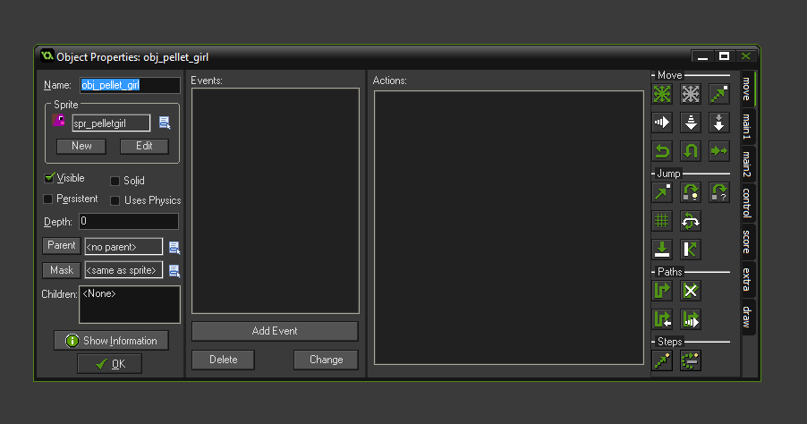
Make Pellet Girl Move
Edit the Pellet Girl object (obj_pellet_girl) by double clicking in the resource tree
Add a Step Event by clicking the Add Event button and choosing Step
Under the control tab on the right side, drag a code block into the step event

Slide 8
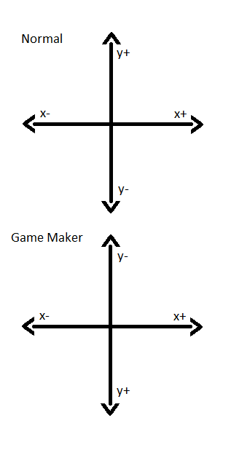
Coordinates – A Quick Review
Game Maker moves characters around in the screen according to x and y positions
Normally positive x is to the right and positive y is up
However, in Game Maker, positive y is down
So, when we want our character to go up, our vertical speed is negative

Slide 9
Make Pellet Girl Move
hspeed = horizontal
vspeed = vertical
We don't want pellet girl to move unless we are pressing a button, so we set both hspeed and vspeed variables to 0
keyboard_check() allows us to see whether a button is being pressed
Every non-character key on the keyboard will start with “vk_” followed by the key name
Test pellet girl by pressing F5
hspeed = 0;
vspeed = 0;
if (keyboard_check(vk_up)) {
hspeed = 0;
vspeed = -1;
}
else if (keyboard_check(vk_down)) {
hspeed = 0;
vspeed = 1;
}
else if (keyboard_check(vk_right)) {
hspeed = 1;
vspeed = 0;
}
else if (keyboard_check(vk_left)) {
hspeed = -1;
vspeed = 0;
}

Slide 10
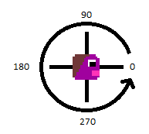
Rotation – A Quick Review
Right now Pellet Girl is facing right, but we want her to face whatever direction she is currently going
Game Maker lets us change the direction of our sprite
Game maker starts with characters at zero degrees, with positive angles rotating the character counter clockwise

Slide 11
Pellet Girl Faces the Wrong Way!
Edit the Pellet Girl object by double clicking in the left panel
Double click on the event code to edit
Now we use a Game Maker variable called image_angle to change the direction pellet girl faces
We want to rotate her 90 degrees to face up
180 degrees to face left
270 degrees to face down
Test with F5
hspeed = 0;
vspeed = 0;
if (keyboard_check(vk_up)) {
hspeed = 0;
vspeed = -1;
image_angle = 90;
}
else if (keyboard_check(vk_down)) {
hspeed = 0;
vspeed = 1;
image_angle = 270;
}
else if (keyboard_check(vk_right)) {
hspeed = 1;
vspeed = 0;
image_angle = 0;
}
else if (keyboard_check(vk_left)) {
hspeed = -1;
vspeed = 0;
image_angle = 180;
}

Slide 12
Now She's Upside Down!
We don't want to rotate Pellet Girl to face left
Instead, we want her mirror image
We need to change her image_angle to 0 when facing left
We can use a variable called image_xscale and set it to -1 to mirror her
Test with F5
hspeed = 0;
vspeed = 0;
if (keyboard_check(vk_up)) {
hspeed = 0;
vspeed = -1;
image_angle = 90;
image_xscale = 1;
}
else if (keyboard_check(vk_down)) {
hspeed = 0;
vspeed = 1;
image_angle = 270;
image_xscale = 1;
}
else if (keyboard_check(vk_right)) {
hspeed = 1;
vspeed = 0;
image_angle = 0;
image_xscale = 1;
}
else if (keyboard_check(vk_left)) {
hspeed = -1;
vspeed = 0;
image_angle = 0;
image_xscale = -1;
}
We need to set the image_xscale
variable for all of the directions
to make sure she is facing the way
we want

Slide 13
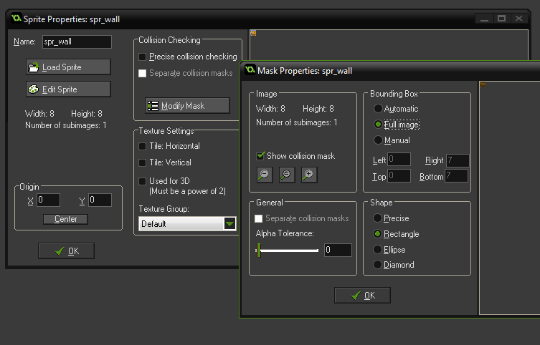
Create a Wall Sprite
Now that we have Pellet Girl moving, its time to start creating our maze!
Right click in Sprites and choose Create Sprite
Name it “spr_wall”
Click on “Load Sprite”
Navigate to the assets/sprites directory and choose the image named “wood_wall.png”
  We have given you a whole folder full of wall images
  When the maze become more complicated, we can make walls with corner angles
We name it spr_wall so that we can tell sprites apart from objects in code
Click on Modify Mask under Collision Checking
Click on Full Image under Bounding Box
Click OK twice, now we have defined the “bounding box” of the sprite

Slide 14
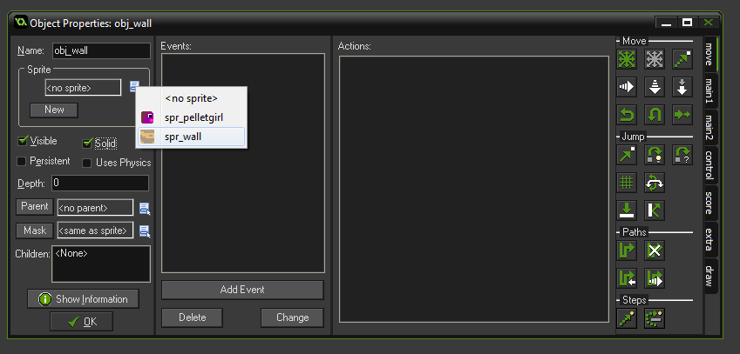
Create Wall Object
Right click in Objects
Choose Create Object
Name it “obj_wall”
Choose spr_wall sprite by clicking on the icon under Sprite
Click the checkbox for Solid

Slide 15
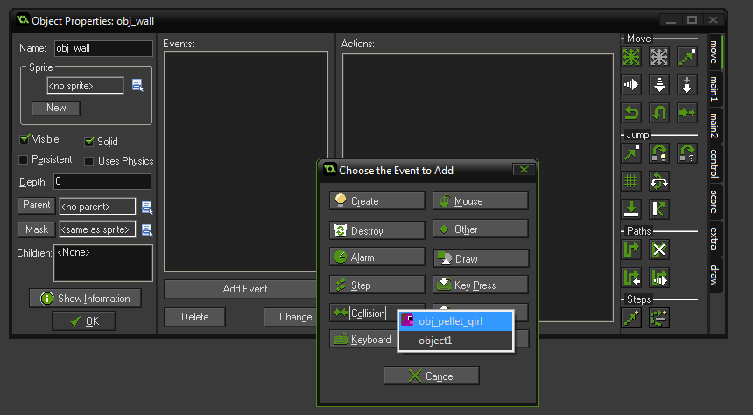
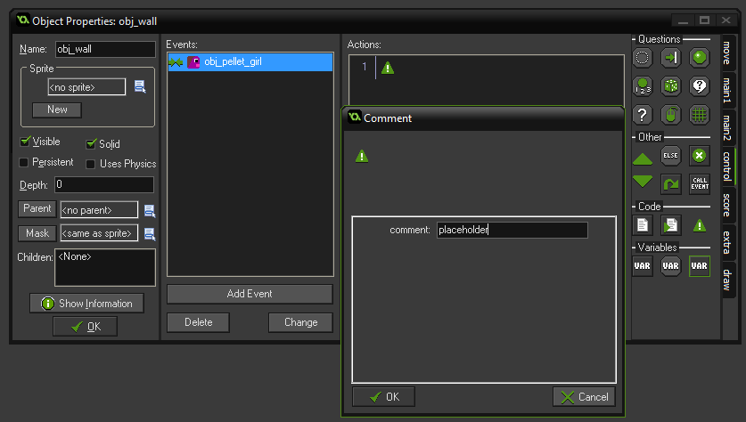
Make Pellet Girl Stop When She Touches the Wall
In the wall object, click Add Event
Click Collision
Choose object “obj_pellet_girl”
Under control on the right, drag a comment block into the event area
Add the word “placeholder” to the comment
Game Maker doesn't like empty events, but we don't need any code for the wall,
so we just add a comment to make Game Maker happy.

Slide 16
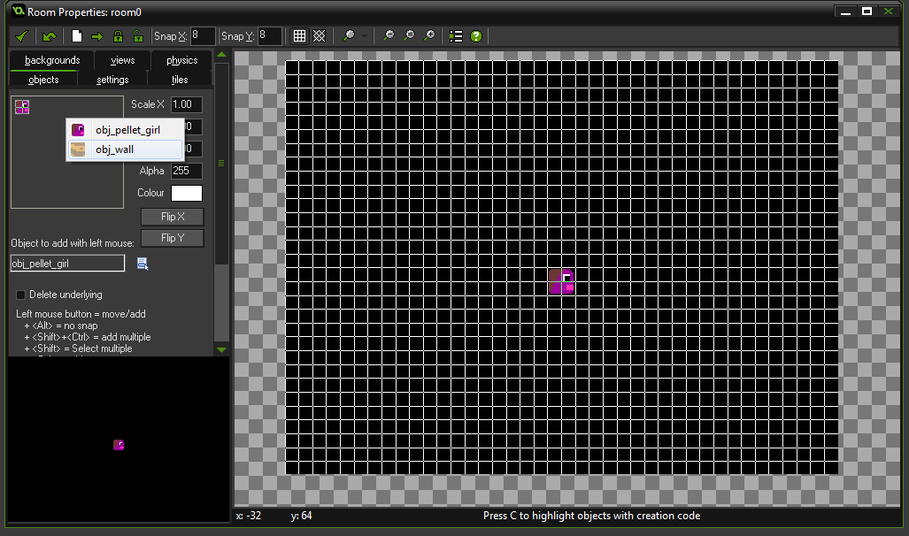
Add Walls to Your Room!
Under Rooms, in the asset tree, double click room0
On the left panel, choose the objects tab
Click on the area with pellet girl and choose “obj_wall”
Change Snap Y to 8 and Snap X to 8
Use Left click to lay a single piece of wall, or Ctrl + Shift + Left Click to put down multiple pieces while dragging
Create a square wall around Pellet Girl
Click the checkmark in top left corner to save
Test by pressing F5 - your character should stop when they encounter a wall.

Slide 17
Speed Up Pellet Girl and Don't Let Her Stop!
To mimic Pacman's continuous movement we need to change the code
Edit pellet girl by double clicking in the asset tree, then edit her step event
Where hspeed and vspeed are -1 or 1, change to -2 or 2
Remove beginning hspeed = 0 and vspeed = 0;
Save the change by checking the checkmark
Test with F5
if (keyboard_check(vk_up)) {
hspeed = 0;
vspeed = -2;
image_angle = 90;
image_xscale = 1;
}
else if (keyboard_check(vk_down)) {
hspeed = 0;
vspeed = 2;
image_angle = 270;
image_xscale = 1;
}
else if (keyboard_check(vk_right)) {
hspeed = 2;
vspeed = 0;
image_angle = 0;
image_xscale = 1;
}
else if (keyboard_check(vk_left)) {
hspeed = -2;
vspeed = 0;
image_angle = 0;
image_xscale = -1;
}

Slide 18
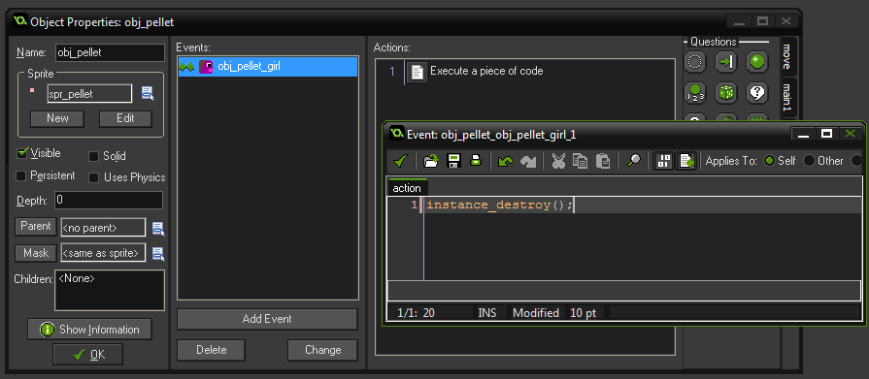
Add a Pellet
Create a new sprite named “spr_pellet” with the dot.png image
  Modify Mask to Automatic, click OK
  Click Center button under Origin
Create a new object named “obj_pellet”
  Choose the pellet sprite
  Add Event → Collision with Pellet Girl
  Drag Code block to Event area
  Add line “instance_destroy();”
  Click OK

Slide 19
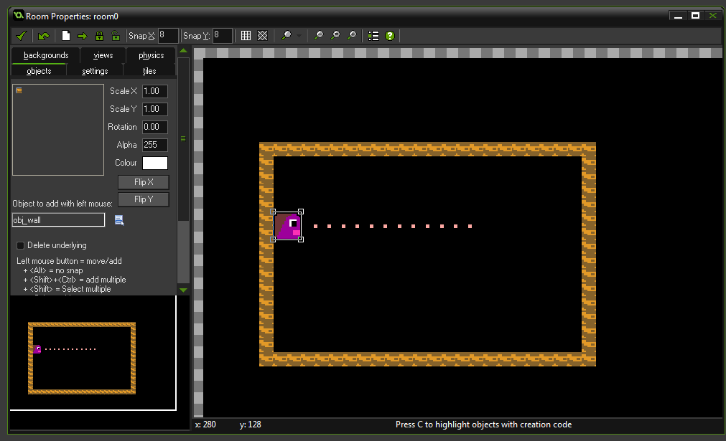
Add Pellets to Room
Edit room0 by double clicking in the left panel
Choose pellet object in the object tab and add many pellets to the room
Save
Test by pressing F5

Slide 20
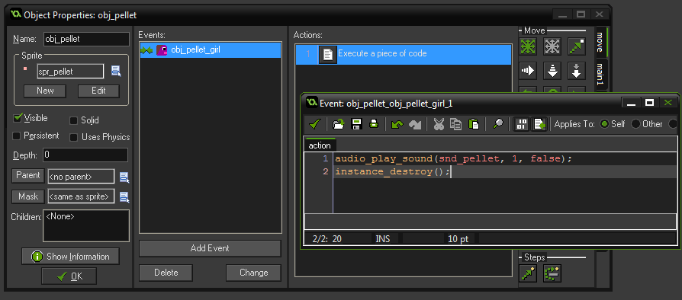
Add a Sound to Eating Pellets
Right click on sounds and choose Create Sound
Name the sound “snd_pellet” and choose the pellet.wav file from the assets/sounds folder
Edit the pellet object's collision event
Change the code block to
audio_play_sound(snd_pellet, 1, false);
instance_destroy();
Save and press F5 to test

Slide 21
Make a Maze in Your Room!
Edit your room0
Use the wall object to create a maze around Pellet Girl
Be sure to give her enough room to walk in between the walls

Slide 22
Steps to Finish Your Game
Create sprites and objects for all of your zombie enemies
Add logic for the zombies to travel the maze and chase Pellet Girl
Add zombie sprays to your maze
Create make the zombies blink when they are destroyable by spray
Create a score board and keep track of the score
Please keep an eye on https://github.com/originalgrego/PelletGirl for additions to this tutorial

Slide 23
Thank you!
Included on your flash drive are the following programs
  Game Maker – A free to evaluate game engine
  Gimp – A free and open source image editor
  Audacity – A free sound editing program
  Reaper – A digital audio workstation program providing convenient licensing
  Blender – A free and open source 3d modeling tool
  Tiled – A free and open source Tile Map editing tool, used for creating complex levels
Please visit https://github.com/originalgrego/PelletGirl for future updates to this project or to help in its development. Pellet Girl is a GPL'd open source project that anyone can contribute to!
We hope you enjoyed Pellet Girl!

